Slide 1
Jones Sausage Road - North Project Update
Community Meeting
December 19, 2023

Slide 2
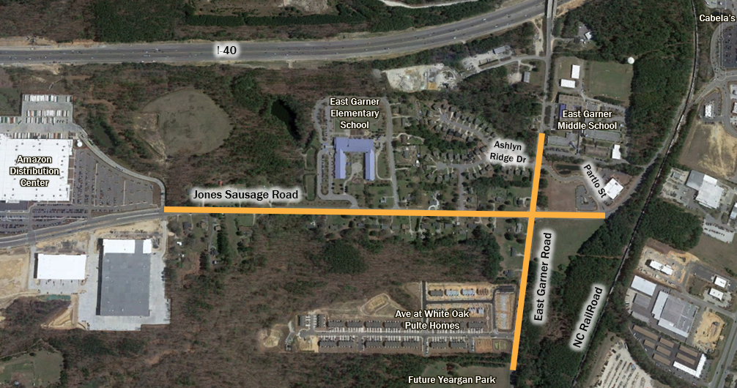
Current Project Scope
Jones Sausage Road Improvements - widened to a four-lane, median divided facility with a 5-foot sidewalk on the east side, and a 10-foot multi-use path (MUP) on the west side from Amazon to Partlo St
East Garner Road Intersection Improvements – add additional turn lanes with storage, pedestrian curb ramps, push buttons at all four corners, bus stop boarding pad, and MUP along the North side

Slide 3
Project Progression
Task | Date
Feasibility Study | January 2020
30% Design | Spring 2022
1st Public Meeting | July 7, 2022
Septic Evaluations and Geotech | June 2023
65% Design and Estimate | September 2023
Update Provided to Council | September 2023
Exploring Value Engineering & Rescoping Options | October – December 2023

Slide 4
Challenges with Current Scope
Findings from Septic Evaluations revealed significant impacts:
11 properties have septic impacts and will need public sewer and water connections
6 properties have well impacts and will need public water connections
4 wells will need to be relocated
2 septic systems will need to be relocated
Right of Way (ROW) and Easement acquisition – will see an increase in cost and risk due to the number of septic and well impacts
With known impacts and additional ROW cost projected, this scope will be over budget by $4.7M

Slide 5
Proposed Project Rescope
South Bound road widening, curb and gutter, MUP eliminated from project scope
Jones Sausage Road Improvements – road widening for the north bound travel lane only, middle lane remains for turning. 5-foot sidewalk, curb and gutter will be added along the east side
East Garner Road Intersection Improvements – remains the same, avoids re-work for future phases

Slide 6
Project Rescope Accomplishments
Reduced Resident Impacts
Removing the south bound travel lane eliminates connecting 7 properties with septic impacts to water and sewer, eliminates connecting 4 properties to water, removes 1 well relocation and 1 septic system relocation
Maintains Improvements to the Critical Need
Improves the Level of Service(LOS) at the Intersection, recent traffic studies reveal existing weekday AM overall LOS is C and the existing weekday PM overall LOS is E
Set up the intersection for the south leg/rail separation improvement
Improves Pedestrian Connectivity
Fills in missing sidewalk between Amazon distribution center to East Garner Rd
Provides curb ramps and pedestrian push buttons at all four corners of the intersection
Provides a bus stop boarding pad at the SW corner of East Garner Rd and Jones Sausage Rd
Financially Feasible
Saves $4.6M in ROW and construction cost

Slide 7
Updated Project Schedule

Slide 8
Thank you for coming! Please share your feedback.

